Slide 1
Food Ordering System
ABC Eatery
Data Flow Diagram

Slide 2
Level 0 : Context Diagram
KITCHEN
ORDERING SYSTEM
0.0
CUSTOMER
MANAGER
SUPPLIER
Identify Sources and Sinks

Slide 3
Level 0 : Context Diagram (Final)
KITCHEN
Order Details
ORDERING SYSTEM
0.0
Order Details
Reports
CUSTOMER
MANAGER
Bill Details
Inventory Order
Details
Inventory Order
Details
SUPPLIER
Identify Data and Flow

Slide 4
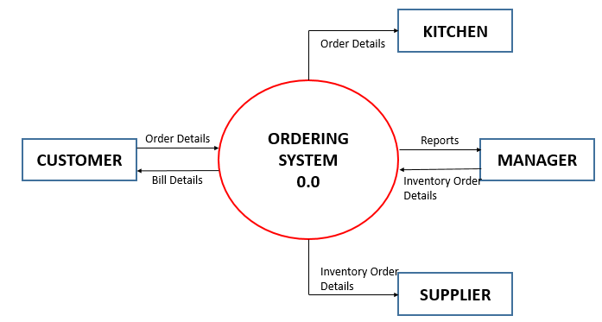
Level 1 : Ordering System
ORDER FOOD
1.0
Order Details
CUSTOMER
Bill Details
Inventory Details
Inventory

Slide 5
Level 1 : Ordering System
ORDER FOOD
1.0
Order Details
CUSTOMER
Order Details
KITCHEN
Bill Details
Order Details
Inventory Details
Order
Inventory

Slide 6
Level 1 : Ordering System
Inventory Details
Inventory
Order
Inventory Details
Order Details
GENERATE REPORT
2.0
Reports
MANAGER
Inventory Order
Details

Slide 7
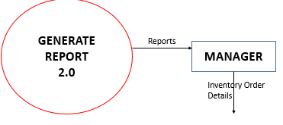
Level 1 : Ordering System
Inventory
Inventory Details
INVENTORY
3.0
Inventory Order
Details
SUPPLIER

Slide 8
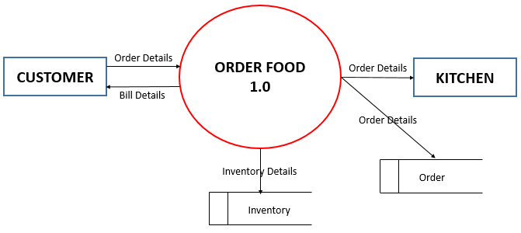
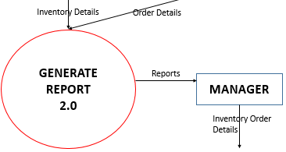
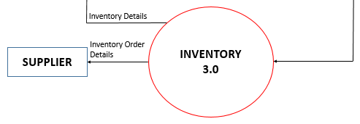
Level 1 : Ordering System (Final)

